Slide 1

Welcome to Unite poc training cy25

Slide 2
The Unite program…
Provide squadron leaders with the maximum flexibility to develop and deliver programs to build cohesion for personnel within their unit.
Ability to “personalize” events to meet the needs and interests of your unit and to help ensure MAX participation.
INCLUDES ALL AIR FORCE ACTIVE DUTY, RESERVIST, GUARD MEMBERS
AND CIVILIANS ASSIGNED TO YOUR UNIT
Spouses and Dependents are NOW AUTHORIZED to receive funding but are NOT counted in your manning numbers – CCs have authority
Spaces NOT Faces
Notes:
The intent of Unite is to provide squadron leaders flexibility that comes in the form of funding for programming and food options from both on and off-installation facilities.
Events must be both recreational and unit-cohesive in order to qualify for Unite Funds. It must also all be inclusive to all Airmen in a squadron and cannot be divided based on rank, pay grade, age, race, gender, or religion.

Slide 3
Unite POC Responsibilities…
Plan, promote and execute events that contribute to unit- cohesion and ensure maximum participation
  X Call Vendors for pricing / request & submit quotes
  X Reservations / contracts / RSVPs / follow-ups (POC or unit rep must sign any/all contracts)
  X PROGRAM CANNOT BE DELEGATED – I CANNOT WORK WITH ANYONE NOT ON THE APPOINTMENT LETTER
Complete and submit required documents for C3 and CC signatures (Event Proposal and Vendor Tracking forms) – CC SIGNATURES MUST MATCH APPOINTMENT LETTER
Schedule and attend shopping trips with C3 (if applicable) – You do the shopping, I come to pay
Capture MINIMUM 3 event photos, coordinate and facilitate team photo
Complete and submit After Action Report (AAR) NLT 5 business days post event
PLAN AHEAD – 3 WEEK DEADLINE TO SUBMIT EVENT REQUESTS FOR REVIEW/PROCESSING
Notes:
AAR – AFTER 2 REMINDERS I WILL HAVE TO EMAIL THE SHIRT/CHIEF OR COMMANDER

Slide 4
C3 Responsibilities…
Primary function is to serve as Unite POC’s focal point for planning, development and coordination of Unite programs/events
Provide formal training and act as liaison for Unite POCs to oversee program execution and adherence to budget
Organization and distribution of funds to eligible squadrons
Provide “Brainstorming” one-on-one sessions with POCs during the planning process
Coordinate all submissions from beginning to end with AFSVC
Execute all purchases in support of Unite events
Notes:
NOTE: Important to remember that this IS NOT A REIMBURSABLE PROGRAM C3 IS TO MAKE ALL PURCHASES FOR UNITE EVENTS

Slide 5
Funding & Allocations…
Two types of funding, PROGRAM AND FOOD FUNDS (APF/NAF)
HARB CY25 Allocation
APF: $22,000.00
NAF: $13,000.00
100/80 rule (100% of NAF NO LESS THAN 80% of APF)
PROGRAM/ACTIVITY FUNDS (APF)
$10.00/ per person assigned
FOOD & BEVERAGE FUNDS (NAF)
$6.00 / per person assigned
MUST be in conjunction with an approved APF event/program
PROGRAM CANNOT BE CENTERED AROUND FOOD – Unite IS NOT a food and beverage program
ALL purchases MUST be able to be made by Credit Card
Contractors and members from other branches of service assigned to your unit are ineligible to receive funding – BUT CAN STILL PARTICIPATE
Notes:
Unite funds are allocated based on per capita end strength according to the Air Force Personnel Center (AFPC), Retrieval Applications Web (RAW).
APF dollars are designated to offset participation cost
The ineligible member can still participate in events they are just not included in your budget nor eligible to receive either type of funding at this time
There is no limit on how many events a squadron can host per year
Unite funds are not to be used with other appropriated or non-appropriated funding. If the cost of the event is above the allotted Unite funding, units may only utilize supplemental funds from non-federal entities (NFE): booster club or personally funded.

Slide 6
on-installation menu…
have your money go further by utilizing fss activities!
Fun Runs/Amazing Race
Pool Party
Squadron Picnic/Fun Day
Golf/Foot Golf/Fling
Private DIY Classes
Squadron Bowling Competition
Axe Throwing
Golf Deck Party – Axe Trailer/Cornhole
Karaoke
Corn-Hole Tournament
Trivia night
Fishing Tournament
Inflatable Obstacle Course
Creative Painting
the list goes on and on and on and on…
HARB is fully equipped w/ an odr, Fitness & Sports Center, & Community Activity Center.
Notes:
FSS related events should be considered first as they are almost all RTE, easy to implement and keep funds on the installation.

Slide 7
Unit-Developed menu…
If you can’t find something to do off base- you aren’t looking hard enough!
Top Golf
Go-Karting
Trampoline Parks
Hiking/Geocaching
Escape Rooms
Ice Skating/Roller Skating
Dave & Busters
Ropes/Climbing Courses
Paintball
Sporting Events
City Tours
Museums
Laser Tag
InDoor Skydiving
Smash Rooms
the list goes on and on and on and on…
just remember it’s only $10.00 per person…
Notes:
UDPs capitalize on opportunities in the local area and often are subjected to a longer approval process – typically 3 weeks turnaround
This is where I can help! We can coordinate a lot of these activities directly through ODR and ITT!
Keep in mind – you have $13.50/per person to spend.
Amusement parks/DJ’s/movies are now authorized

Slide 8
Volunteer menu…
Work for a cause, not for applause!
Meals On Wheels
Food Banks
Community Cleanups
Habitat for Humanity
Humane Society
You can be approved for food funds for volunteer events
Notes:
Charitable work provides a cost effective team building activity that allows co-workers to see each other in a new light while making a difference in the community. NO approval needed for these events unless you are requesting food funding.

Slide 9
food…
🍔
FSS OPTIONS
Falcon’s Nest Club
BJ’s
OFF INSTALLATION
Anywhere that takes a CC
just remember it’s only $6 per person…
Food funds can only be used in conjunction with an approved unite event
Notes:
The Unite program is activity-based, and NAF dollars are only an added benefit. NAF funds must be directly in conjunction with an approved Unite event. Unite is not a food and beverage-based program; an event centered on just eating without an approved Unite cohesive and or team building event is NOT authorized and will not be approved.

Slide 10
You can also pay for…
Paper Plates
Cups
Utensils
Napkins
Charcoal/Propane
Decorations
  X NO more than 10% of Budget
Foil, Foil Pans
Room Fees
Pavilion/Equipment Rental
tents/tables/chairs
Rentals ONLY – it won’t be approved for purchase

Slide 11
New to this year menu…
The AF got tired of the program being soooooo restrictive so, they found a way to yes!
Family Friendly
Kids activities
Inflatables for small humans
Artists: balloon, face painting
Petting zoos
No more than 50% of your Budget can go towards these activities
Events CANNOT be geared towards Families and Unite cannot host events for dependents ALONE
AND THEN….
DJs ARE BACK!!!!
WATER PARKS
THEME PARKS
MUSICAL THEATER
FAIRS / THEMED EVENTS (THINK RENAISSANCE, MARDI GRAS OR PRIDE)
MOVIES
MUST BE FOR A SPECIFIC MOVIE / DAY/ TIME
Notes:
UDPs capitalize on opportunities in the local area and often are subjected to a longer approval process – typically 3 weeks turnaround
This is where I can help! We can coordinate a lot of these activities directly through ODR and ITT!
Keep in mind – you have $13.50/per person to spend.

Slide 12
New to this year menu…
HOLIDAY ACTIVITES
UGLY SWEATER COMPETITIONS
GINGERBREAD HOUSE/TOWNS COMPETITIONS
SQUADRON HOLIDAY CARD COMPETITION
CREATE/MAKE A WREATH – EASTER, 4TH OF JULY, CHRISTMAS, ETC.
HOLIDAY PARTIES ARE NOT AUTHORIZED
Notes:
UDPs capitalize on opportunities in the local area and often are subjected to a longer approval process – typically 3 weeks turnaround
This is where I can help! We can coordinate a lot of these activities directly through ODR and ITT!
Keep in mind – you have $13.50/per person to spend.

Slide 13
Unite funds cannot be used for…
HOLIDAY PARTIES (EOY EVENTS)
- THIS IS STILL A THING
Events with no Unit-Cohesion
Alcohol or Gambling (INCLUDES BINGO)
COMBAT DINING IN/OUT
Change of Commands/Meet & Greets
Squadron Training/Meetings
PROMOTIONS/RETIREMENTS
SUPPLIES FOR VOLUNTEER EVENTS
Rentals of Portable Johns, Trash/Cleaning Services, Lodging, Transportation
Equipment Purchases
Prizes, Giveaways, Awards, PROMOTIONAL ITEMS
Damages or Late Fees, Taxes, Tips, or Gratuities, AND/OR INSURANCE
PPE – Gloves, sanitizer, cleaning supplies, masks
NON-INCLUSIVE EVENTS
Notes:
December holiday, Christmas, Hanukkah, End of Year celebrations are typically subsidized by squadron booster club funding. If December holiday parties were allowed, Unite funds would be utilized every year for this celebration only, which is not the intent of the program.
SUPPLIES FOR VOL EVENT – PAINT, TOOLS, GLOVES ETC…
(examples: trophies, medals, plaques, banners, marketing/advertisements, apparel, cups, personalization of objects, murals, shirts, hats, and jerseys)
Unite events must be inclusive to all Airmen and Guardians in a squadron and cannot be divided based on rank, pay grade, age, race, gender, or religion.
The Unite program was created specifically for squadrons and sub-sets of squadrons.

Slide 14
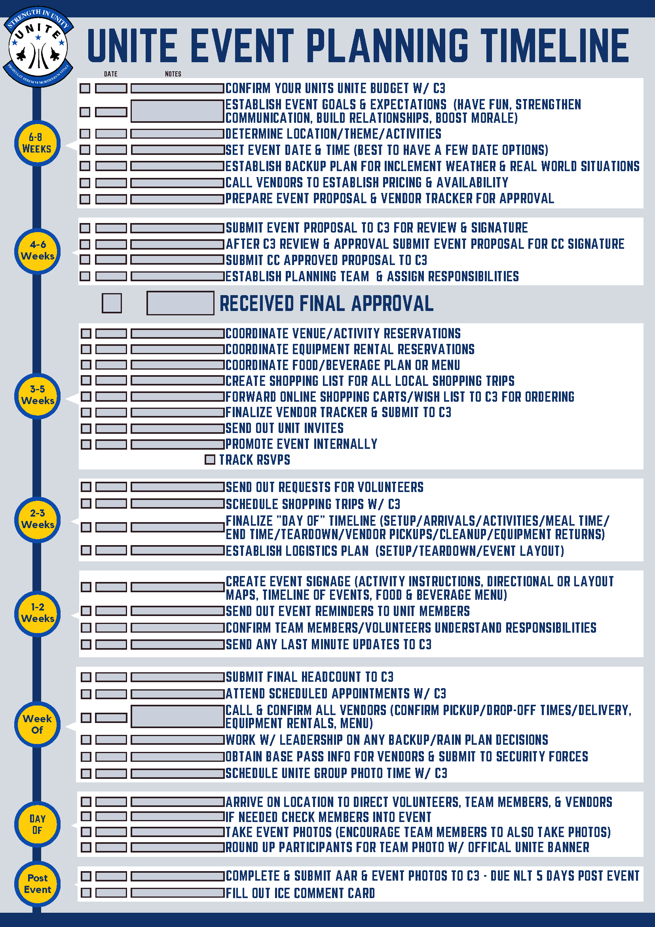
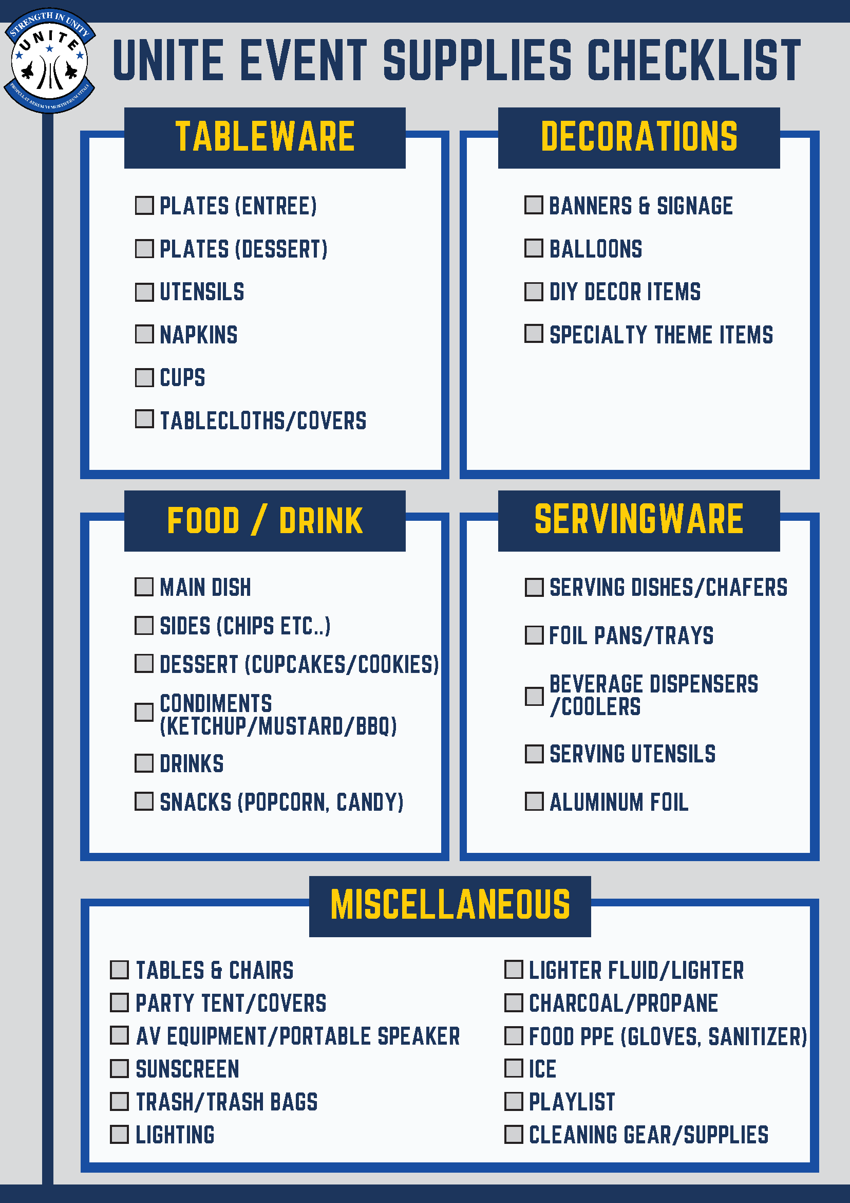
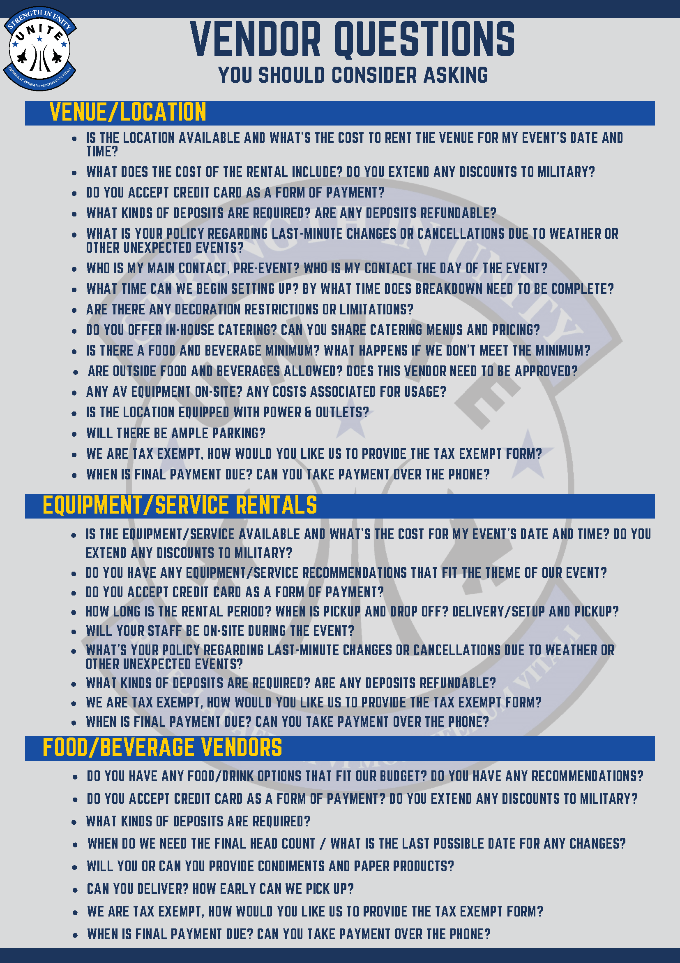
planning your event
Use this planning timeline as a guide to help stay organized
Use the supply checklist as a reminder of items you may or may not need for your event
Refer to the last page for examples of questions you can ask your vendors
Notes:
Quick NOTE – If you are paying for a “butts-in-seats” event you must utilize a RSVP system and give me a headcount based on the deadline of your vendor; if you do not, EXAMPLE: The Edge – you’ve requested for 100 ppl but do not confirm with vendor, that is not their fault and I will be paying for the full 100 ppl – your unit will essentially lose that money.
**ODR “picnic kits” are no longer authorized under Unite

Slide 15
event submission process
Important:
ALL BOXES MUST BE FILLED OUT
BE VERY SPECIFIC IN YOUR DESCRIPTION
INCLUDE FOOD PLAN & ANY FEES PARTICIPANTS ARE PAYING
BREAK DOWN THE FUNDING - TOTAL IT ALL UP
CC MUST AUTHORIZE DEPENDENT PARTICIPATION
Example:
ODR - $200
Tables, Chairs, Corn Hole, Inflatable, Coolers, Charcoal Grill
Game Time - $525
Mobile Game Truck, Mobile Laser Tag
Elite - $625
Rock Wall (labor, delivery, setup)
$200 + $525 +$625 = $1350 / 100 participants
= $13.50/per person
YOUR COMMANDER’S SIGNATURE IS REQUIRED FIRST
C3 REVIEW AND SIGNATURE IS REQUIRED SECOND
ALLOW MINIMUM OF 3 WEEKS FOR FINAL APPROVAL
Remember this is NOT a local approval
Notes:
You will also need to be very specific on what activities you are doing. As this won’t be a local approval people looking at it from AFSVC won’t know where you’ll be and what you will be doing there so no detail is too small. Funding sections must also be very detailed. You will also need to submit what food or food options the $5 are being spent on so please include that in your proposal.

Slide 16
vendor tracker
Why this form is required:
Ensures all payments are made to the correct vendor and location
Ensures all payments are made on time
Helps C3 answer common vendor questions, what are we paying for, how many, who was the reservation made with, etc…
1 vendor per line unless BOTH APF and NAF Expenses are being utilized; Example – Commissary
PLEASE MAKE SURE PAYMENT AMOUNTS ARE ACCURATE

Slide 17
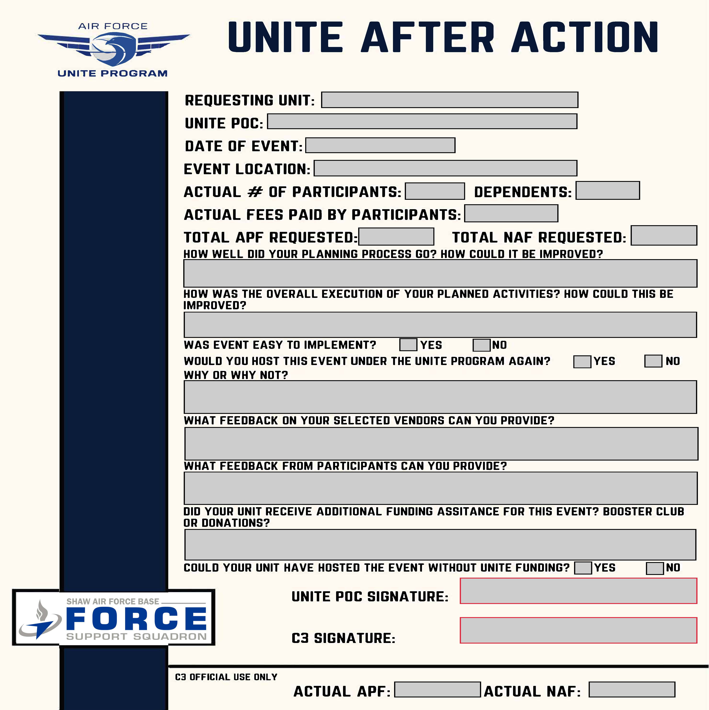
After action report
Important:
AARs AND PHOTOS are due NLT 5 business days post event
All blocks must be filled out
We would also like feedback and input from members in the unit so make sure to ask around!
These AARs are looked at by A LOT of people so be honest and specific
BE DETAILED – NO ONE WORD ANSWERS PLEASE
AARs only require the POCs signature

Slide 18
Thanks for attending!!
Any questions?
You can find me at
Cori.johnson.1@us.af.mil
786-255-0288 cell
786-415-6100
BLDG 404 Room 105 – 482 FSS

